Slide 1
Do loop diuretics cause hypercapnic respiratory failure?
Brian Locke, MD
Intermediate Epidemiology
12-7-2021
Notes:
This should be approximately 15-20 minutes in length. Your slides should describe specific aims and approach. No more than 1 background slide. Presentations will take place during the last week of class and "Final Exam" week.

Slide 2
Outline
Background
General hypothesis / Specific Hypothesis
Design considerations
Population
Exposure of interest
Outcomes
Data source (and population)
Study design
Data analysis
Anticipated limitations
Notes:
[ ] additional background reference:
Bear R, Goldstein M, Phillipson E, Ho M, Hammeke M, Feldman R,
et al. Effect of metabolic alkalosis on respiratory function in patients
with chronic obstructive lung disease. Can Med Assoc J 1977;117(8):
900-903.

Slide 3
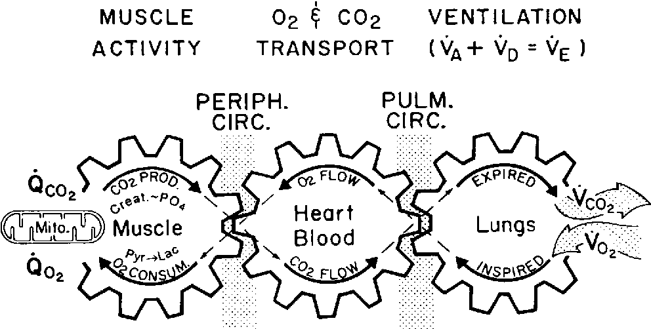
If the R ‘sprocket’ (lung) turns too slowly relative to the R sprocket (muscle), CO2 build up in the blood
This is hypercapnic respiratory failure
Similar: ‘hypoventilation’
There are 2 types of causes:
The lung ventilation is severely broken (sprocket can’t turn fast)
The ‘controller’ doesn’t crank up the speed of the sprocket.
Patients with Hypercapnia
How does the brainstem know how fast to turn the sprocket?
CO2, pH, and O2 in the blood
Loop diuretics increase pH
The metabolic rate (L sprocket)
Sleep (decrease), Anxiety (increase)
Notes:
Schematic of biochemistry of O2 and CO2 – controlled by several complex systems that interact in interesting ways to maintain homeostasis (usually)
Lung ventilation severely broken: scarred lung, asthma, weak muscles
Controller problems:
In sum, loop diuretics are KNOWN to influence 1, among many, of the determinants of blood CO2 levels. It is NOT known if this makes a meaningful effect.

Slide 4
General hypothesis: Loop diuretic prescription causes hypercapnic respiratory failure in patients with certain predisposing conditions.
to
Operational hypothesis: New or increased loop diuretic prescription on discharge from a hospitalization for hypercapnic respiratory failure is independently associated with increased risk of readmission for hypercapnic respiratory failure within 30 days

Slide 5
Design Considerations
There is a physiologic rationale for why loop diuretics might cause hypercapnic respiratory failure, but no empirical evidence.
I hypothesize they do. What study design has the best chance of demonstrating a causal relationship, if one exists?
Challenges:
Hypercapnic respiratory failure is uncommon and can be acute or chronic.
The symptoms are variable, and the diagnosis is frequently missed.
Each case of hypercapnic respiratory failure may have several necessary causes.
Prior research exclusively focused on sufficient causes
Perhaps effect modification?
Patients who develop hypercapnic respiratory failure have many comorbidities that may act as confounders
Untreated sleep apnea
Loop diuretic
Obstructive Lung disease
vs
Obesity Hypoventilation
Syndrome

Slide 6

Population
If this effect (loop diuretic → hypercapnia) exists, who would it be most apparent in?
High risk of developing hypercapnic respiratory failure
Patients with reliable data completeness
Ideally, a relatively homogenous population
Proposal: Adult patients with an admission for hypercapnic respiratory failure

Slide 7
Exposure: receipt of loop diuretics
Furosemide (40mg) = Torsemide (20mg) = Bumetanide (2mg)
Physiologic rationale suggests higher dose = higher risk of hypercapnia
Rx: temporary (usually in the hospital) or chronic (outpatient)
Indication for prescription? Given for hypervolemia (swelling)
People with worse tendency for swelling probably have higher risk for readmission
We’d like to compare people who differ only in their diuretic prescription
For the unexposed group: when might they have been exposed? (rx’d)
Proposal: New or increased loop diuretic on discharge from the index hospitalization with hypercapnia
Notes:
Not idiosyncratic

Slide 8
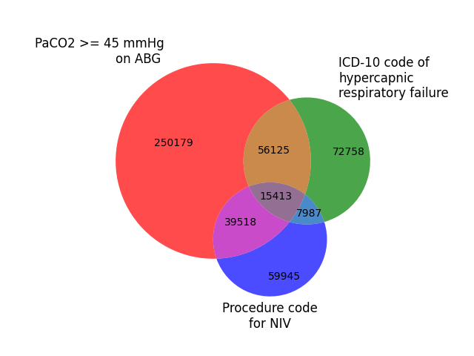
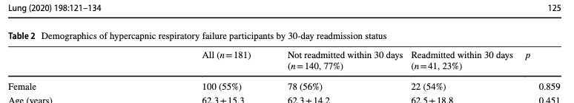
Primary Outcome
Hypercapnic respiratory failure is often not correctly diagnosed.
ICD codes are not reliable²
Diagnostic testing only in certain situations (hospital admission or sleep apnea evaluation)
How long would the loop diuretic effect take?
Readmission rates are high¹
Proposal: Time to readmission with
any respiratory failure (ICD code)
and blood gas with CO2 over 45 mmHg.

Slide 9
Data Source (and population)
 | Veterans Affairs | TriNetX | Medicare Claims | UPDB w Linkage
Defined Population | +++ | - | ++ | ++
Generalizability | + (demographics) | ++ | ++ | - (elevation, demographics)
Lab completeness | ++ | ++ | - | +
Diagnosis completeness | + | ++ | ++ | +
Pharmacy completeness | + | - / ? | + | +
Ease of access to data | + | +++ | + | +
Sample Size | ++ | +++ | ++ | +
Proposal: among Veterans who receive care at VHA hospitals.
Notes:
Methods: doi: 10.1093/sleep/zsy058
“The cohort was defined using VHA Medical SAS Datasets for
outpatient visits and inpatient admissions from fiscal years (FY)
2006 through 2012 (VHA fiscal year is from October–September).
The outpatient database includes all outpatient visits at the VHA
outpatient clinics (hospitals and Community-Based Outpatient
Clinics [CBOCs]). Each outpatient record contains a primary diagnosis,
up to nine additional secondary diagnoses, as well as current
procedural technology (CPT) procedure codes. All diagnosis
codes follow the International Classification of Diseases, Ninth
Revision, Clinical Modification (ICD-9-CM) coding system [20].
The inpatient database includes all inpatient admissions that
occurred at VHA hospitals nationwide. Each inpatient record
contains the primary diagnosis and up to 12 additional secondary
diagnoses. We also used the inpatient encounters database,
which contains records of outpatient encounters that occurred
during a hospitalization. In addition to care received at VHA
facilities, veterans may be eligible for benefits to receive care
at non-VHA facilities. These data are recorded in the VHA Feebasis
database and includes diagnosis and procedure codes for
both inpatient and outpatient care. Thus, we also included these
databases because not all VHA clinics have sleep laboratories
(lab) available for sleep testing, and in such cases, patients are
referred to the private-sector sleep labs to undergo sleep studies.
Given that opioids and sedatives have been associated with
sleep-disordered breathing, opioid and sedative medication
data from the Decision Support System (DSS), VHA outpatient
pharmacy database containing medication name and days supply
was also used to track patient medication use. Finally, we
used the VHA’s Corporate Data Warehouse Vital Signs table to
obtain information on patient height and weight.
“

Slide 10
Study Design
 | Cohort Study | Case-control study
Evaluate multiple outcomes? | + | -
Evaluate multiple exposures? | - | +
Efficiency | Mitigated by EHR data-source | +
Proposal: cohort study with exposure group defined by increase (or new) loop diuretic Rx on discharge
Other outcomes of importance:
Time to readmission with any type of respiratory failure
If ’harm’ is outweighed by other benefits, not so important.
Time to readmission for any cause
Secondary: 30-day outcome assessments to allow comparability with prior literature and quality metrics.

Slide 11
Data Analysis
Outcome measure: Hazard Rate Ratio of Readmission or Death
‘Survival’ defined as neither readmitted nor dead.
Rationale:
exact timing of effect is not known (has never been previously demonstrated), thus choosing a given time-point runs the risk of failing to find a real effect due to inappropriate time of outcome assessment.
Risk of readmission may vary over time (high initially? lower as time passes?)

Slide 12
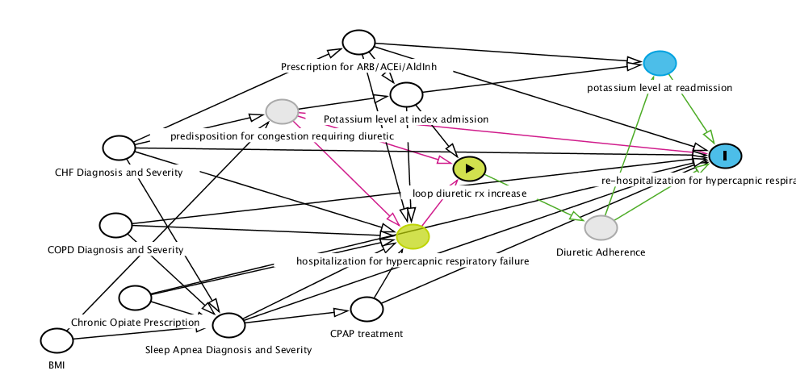
Confounding
Many confounders and possible effect modifiers
Add BNP to the below list
Proposal: Multivariable analysis using log-binomial regression (for RR)
Propensity score / Inverse probability of treatment weighting ? Likely to have many outcome events per covariate. Thus, no data reduction techniques
Entire Cohort | Risk No Diuretic Increase (95% CI) | Risk Diuretic Increase (95% CI) | Unadjusted RR (95% CI) | Adjusted RR (95% CI)
30d readmission with hypercapnic respiratory failure | __ ( __ to __) | __ ( __ to __) | __ ( __ to __) | __ ( __ to __)
30d readmission with any respiratory failure | __ ( __ to __) | __ ( __ to __) | __ ( __ to __) | __ ( __ to __)
30d readmission of any cause | __ ( __ to __) | __ ( __ to __) | __ ( __ to __) | __ ( __ to __)
Notes:
Exposures = green
Outcomes = blue

Slide 13
Power / Sample size feasibility
Desired alpha: 0.05, Desired power: 0.80
Expected 30d readmission rate in non-diuretic increase arm? 16%¹
Anticipated exposure rate (increase in diuretics)? 15%³⁻⁴
Lowest clinically meaningful relative risk reduction? 20%
Stata: sampsi 0.16 0.128, power(0.8) ratio(5.667)
Loop diuretic increase at index hospitalization discharge: n=1117
No loop diuretic increase at index hospitalization discharge: n=6331
Doable with a nationwide dataset
Number of patients meeting various definitions of hypercapnic respiratory failure from TriNetX over 3 years

Slide 14
Limitations
Missing values? Hospitalizations (outcome) expected to be completely ascertainable, but the presence/absence of covariates might not
Residual confounding? Predisposition to fluid overload likely to influence both likelihood of loop diuretic prescription and risk of readmission. Hard to quantify directly (CHF diagnosis as surrogate)
Sensitivity analysis? E-value?
Applicability to other patients with hypercapnia who have not been hospitalized? Would need separate study focusing on outpatient prescriptions.

Slide 15
Summary
To investigate this relationship, we propose a retrospective cohort study of patients in the Veterans Healthcare Administration (VA) admitted for hypercapnic respiratory failure. We will determine the 30-day readmission rate with hypercapnic respiratory failure among individuals who receive a discharge prescription for a new or increased dose of a loop diuretic with those who do not.
Hypothesis: We hypothesize that new or increased loop diuretic dose on discharge from an admission with hypercapnic respiratory failure will lead to an increased risk of readmission with the same condition within 30 days.
Aim: We will compare readmission rate within 30 days for hypercapnic respiratory failure among patients whose index admission discharge prescription for a loop diuretic is increased with patients whom the discharge prescription is unchanged or decreased. As a sub-aim, we will also evaluate whether the rate of rehospitalization with any type of respiratory failure or the rate of rehospitalization for any cause differs between the two groups.

Slide 16
References
Meservey, A. J., Burton, M. C., Priest, J., Teneback, C. C., & Dixon, A. E. (2020). Risk of readmission and mortality following hospitalization with hypercapnic respiratory failure. Lung, 198(1), 121-134.
Locke B. W., Sundar K. M., Brown J. M., Gouripeddi R. “Common Methods of Identifying Hypercapnic Respiratory Failure Produce Meaningfully Different Cohorts”. Unpublished data. Submitted to American Thoracic Society 2022 Conference.
Alshibani, M., Alshehri, S., Alyazidi, W., Alnomani, A., Almatruk, Z., & Almeleebia, T. (2020, July). The Impact of Discharged Loop Diuretic Dose to Home Dose on Hospital Readmissions in Patients with Acute Decompensated Heart Failure: A Retrospective Cohort Study. In The heart surgery forum (Vol. 23, No. 4, pp. E470-E474).
DeVore, A. D., Hasselblad, V., Mentz, R. J., O'Connor, C. M., Armstrong, P. W., McMurray, J. J., ... & Hernandez, A. F. (2015). Loop diuretic dose adjustments after a hospitalization for heart failure: insights from ASCEND‐HF. European journal of heart failure, 17(3), 340-346.

Slide 17
Subsequent evidence accumulated: Verbraecken and McNicholas: Respiratory mechanics and ventilatory control in overlap syndrome and obesity hypoventilation. Respiratory Research 2013 14:132. doi:10.1186/1465-9921-14-132 https://link.springer.com/content/pdf/10.1186/1465-9921-14-132.pdf
Deficient bicarbonate excretion (?equivalent, overzealous chloride secretion) could explain a tendancy to retain HCO3 and blunt ventilatory response[100, 171, 168]
100 - 100. Piper AJ: Obesity hypoventilation syndrome – the big and the breathless. Sleep Med Rev 2011, 15:79–89.
171 - 171. Berger KI, Goldring RM, Rapoport DM: Obesity hypoventilation syndrome. Semin Respir Crit Care Med 2009, 30:253–261.
168 - 168. Norman RG, Goldring RM, Clain JM, Oppenheimer BW, Charney AN, Rapoport DM, Berger KI: Transition from acute to chronic hypercapnia in patients with periodic breathing: predictions from a computer model. J Appl Physiol 2006, 100:1733–1741
“Chronic daytime hypercapnia would emerge if both the acute ventilatory compensation for transient nocturnal hypercapnia is compromised, as well as the bicarbonate excretion, as might be seen under condition of hypoxia (f.i. chest infection), diuretic therapy, or heart failure [170,178]. This makes both patient categories more susceptible to acute ventilatory failure [126].
126. BaHamman A: Acute ventilatory failure complicating obesity hypoventilation: update on a ‘critical care syndrome’. Curr Opin Pulm Med 2010, 16:543–551.
170. Gifford AH, Leitter JC, Manning HL: Respiratory function in an obese patient with sleep-disordered breathing. Chest 2010, 138(3):704–715.
178. Chau EHL, Lam D, Wong J, Mokhlesi B, Chung F: Obesity hypoventilation syndrome. A review of epidemiology, pathophysiology, and perioperative considerations. Anesthesiology 2012, 17(1):188–205.

Slide 18
Other new data: https://www.nejm.org/doi/pdf/10.1056/NEJMoa2203094 ADVOR Trial
Lasix + acetazolamide vs Lasix alone
?any difference in readmission or rates of hypercapnia?

